Slide 1








Optimizing Aviation Insights: A Data Engineering Approach for Analyzing Flight Delays and Cancellations
A Data Engineering Case Study
Presented by- D Bhanu prakash
Santhkumar Ankala
V Siri Vaishnavi

Slide 2

Problem Statement
The Business Problem
U.S. domestic flights experience major delays & cancellations
DOT–BTS provides historical datasets (2015) with delays, cancellations & diversions
Need a pipeline that analyzes delay trends, reasons, real-time updates, and predictive insights
Challenges
Multiple data sources
Real-time + historical merge
Data quality & standardization
Scalable ingestion & transformation

Slide 3


Project Objective
Build an end-to-end scalable cloud data pipeline
Ingest flight datasets via AWS S3 → Snowflake
Use Snowpipe for automated Bronze ingestion
Apply cleansing, transformations, and modeling with dbt and snowpark
Integrate historical + real-time (flights_latest.csv) data
Create a dimensional model (Star Schema)
Build Gold layer fact & dimension tables
Show Snowflake Time Travel
Create analytics & dashboards for delay insights

Slide 4
Project Overview
Build an Airline Analytics Data Pipeline using Snowflake and dbt.
Implement Bronze, Silver, and Gold layers for raw, cleaned, and curated data.
Create dimension and fact tables for flights, airlines, airports, and dates.
Apply SCD Type 2 and Time Travel for historical tracking and data recovery.
Enable dashboards, analytics, and business insights with clean, reliable data.

Slide 5
Tools & Technologies Used
Snowflake – Cloud data warehouse for storage, SQL transformations, Streams, Tasks, and SCD2 logic
dbt Cloud/Core – ELT modeling framework for building dimensions, facts, tests, and documentation
AWS Glue + PySpark – Used to preprocess raw files (CSV → Parquet)
Snowpark (Python) – In-Snowflake transformations for Silver-layer cleaning, standardization, and feature creation
AWS S3 – S3 as raw data landing zone
Streamlit - Streamlit for dashboarding and KPI visualization
GitHub – Version control for dbt models, documentation, and collaborative development.
Data Sources
Batch Data
Airlines
Airports
Flights Historical (2015)
Streaming Data
Flights Latest (Incremental)
Formats & Storage
CSV files stored in AWS S3
Loaded into Snowflake via Snowpipe

Slide 6

High-Level Architecture
AWS S3 (CSV / Parquet)
↓
Snowpipe (Auto-Ingest)
↓
Bronze Layer (Raw)
↓
Silver Layer (Cleaned / Standardized)
↓
snowpark transformations, dbt Transformations, Macros
↓
Gold Layer (Dimensional / Fact / Aggregations)
↓
Dashboards (Snowflake / Streamlit)

Slide 7
Medallion Architecture (Snowflake + dbt)
Bronze Layer (Raw Ingestion): Data auto-ingested from S3 using Snowpipe, stored in raw form for lineage and auditability.
Silver Layer (Clean & Standardized): Performed core transformations using Snowpark + dbt, including cleansing, type casting, surrogate key generation, and enrichment.
Gold Layer (Curated Business Layer): Applied SCD2 on dimensions and built final Dims & Fact tables optimized for analytics, reporting, and time-travel demonstrations.
Processing Approach: Used a mix of auto-ingestion (Snowpipe) and batch processing for curated transformations.
Visualization Layer: Gold datasets consumed for insights and dashboards such as airline delay comparisons, trends, and performance KPIs.

Slide 8
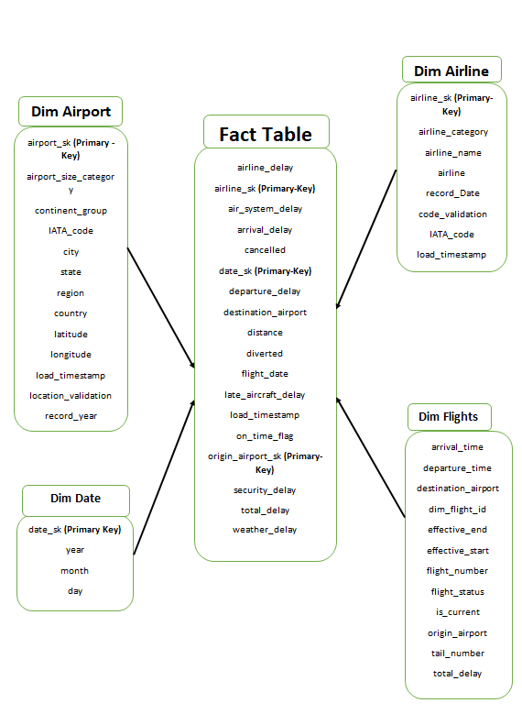
Data Modelling(Star Schema)

Slide 9
Working Flowchart of SCD 2 Using streams
┌──────────────────────┐
│ Raw CSV (Bronze) │
└──────────┬───────────┘
│
▼
┌──────────────────────┐
│ Silver Flights Table │
│ (Cleaned & Standard) │
└──────────┬───────────┘
│
Snowflake Stream
│
▼
┌────────────────────────┐
│ Latest Changed Records │
│ (ROW_NUMBER filter) │
└──────────┬─────────────┘
│
SCD2 Stored Procedure
│
┌─────────────────────┴──────────────────────────────┐
│ │
▼ ▼
Close old record Insert new version
(effective_end ← now) (effective_start ← now)
(is_current ← 'N') (is_current = 'Y')
│ │
└─────────────────────┬───────────────────────
▼
┌────────────────────────┐
│ DIM_FLIGHTS (SCD2) │
│ Full Version History │
└────────────────────────┘

Slide 10
Data Processing Approaches
Batch Processing
AWS Glue + PySpark used for optional preprocessing and schema validation before landing data
Snowpark and dbt models perform batch cleansing, standardization, and enrichment in Silver layer
Batch transformations generate curated Gold datasets for KPIs, aggregations, and reporting
Periodic batch runs refresh facts, dimensions, and aggregated marts for dashboards
Streaming / Incremental Processing
Snowpipe automatically ingests new files from S3 → Bronze Layer with zero manual triggers
Snowflake Streams monitor Silver tables for row-level inserts and updates
SCD Type-2 implemented using Streams + MERGE to version flight-level dimensional data
Incremental processing pipeline ensures only changed flights are updated in Dim & Fact table
s

Slide 11
Data Quality checks
Time Travel
Safe experimentation: Copied the flights table to try changes without affecting original data.
Simulate changes: Deleted specific flight records.
Recover historical data: Viewed past versions of the table to restore deleted records.
Permanent clone with retention: Created a clone that keeps historical data for a set period.
Key benefit: Enables data recovery, auditing, and rollback safely and efficiently.
Validated:
Null checks
Unique primary keys
Referential integrity
Delay value ranges
Timestamp consistency
Implemented dbt tests for automated checks.

Slide 12

Dashboard Visualizations and Insights
Aviation Performance Visualizations - This section of the dashboard highlights key aviation metrics, showing totals for flights, delays, cancellations, and the overall average delay
Delay trend over time - This chart shows how average flight arrival delays steadily increase over time across the selected flight dates.
Airline Delay Comparision - A comparison of average arrival delays across major U.S. airlines, highlighting which carriers consistently run early or late.
Cancellation Rate by airline - This chart compares cancellation rates across airlines, showing that American Eagle has the highest cancellation rate among them.
Route Delay Heatmap - A route-level heatmap visualizing average delays between origin–destination airport pairs, helping identify the most delay-prone flight routes.
Monthly Average Delay - The chart shows that the average arrival delay increases steadily from January to March 2015.

Slide 13
THANK YOU

